Slide 1
8
VECTORS AND THE
GEOMETRY OF SPACE
Copyright © Cengage Learning. All rights reserved.

Slide 2
8.1
Three-Dimensional Coordinate Systems
Copyright © Cengage Learning. All rights reserved.

Slide 3
Three-Dimensional Coordinate Systems
To locate a point in a plane, two numbers are necessary. We know that any point in the plane can be represented as an ordered pair (a, b) of real numbers, where a is the
x-coordinate and b is the y-coordinate.
For this reason, a plane is called two-dimensional. To locate a point in space, three numbers are required. We represent any point in space by an ordered triple (a, b, c) of real numbers.

Slide 4
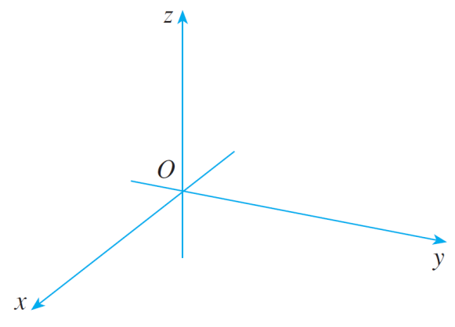
Three-Dimensional Coordinate Systems
In order to represent points in space, we first choose a fixed point O (the origin) and three directed lines through O that are perpendicular to each other, called the coordinate axes and labeled the x-axis, y-axis, and z-axis.
Usually we think of the x- and
y-axes as being horizontal and
the z-axis as being vertical, and
we draw the orientation of the
axes as in Figure 1.
Coordinate axes
Figure 1

Slide 5
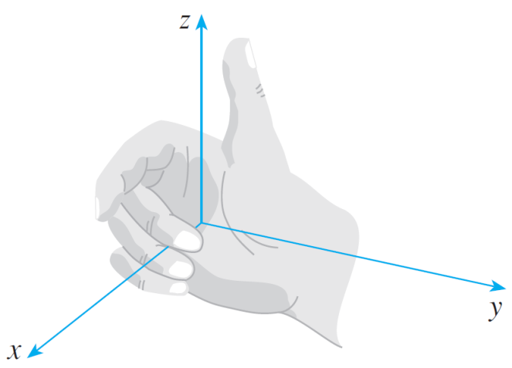
Three-Dimensional Coordinate Systems
The direction of the z-axis is determined by the right-hand rule as illustrated in Figure 2: If you curl the fingers of your right hand around the z-axis in the direction of a 90° counterclockwise rotation from the positive x-axis to the positive y-axis, then your thumb points in the positive direction of the z-axis.
Right-hand rule
Figure 2

Slide 6
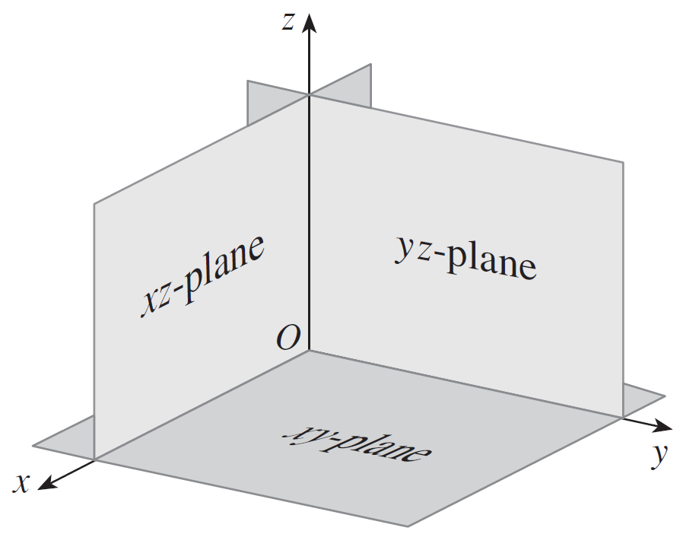
Three-Dimensional Coordinate Systems
The three coordinate axes determine the three coordinate planes illustrated in Figure 3. The xy-plane is the plane that contains the x- and y-axes; the yz-plane contains the y- and z-axes; the xz-plane contains the x- and z-axes.
Coordinate planes
Figure 3

Slide 7
Three-Dimensional Coordinate Systems
These three coordinate planes divide space into eight parts, called octants. The first octant, in the foreground, is determined by the positive axes.
Now if P is any point in space, let a be the (directed) distance from the yz-plane to P, let b be the distance from the xz-plane to P, and let c be the distance from the
xy-plane to P.
We represent the point P by the ordered triple (a, b, c) of real numbers and we call a, b, and c the coordinates of P; a is the x-coordinate, b is the y-coordinate, and c is the
z-coordinate.

Slide 8
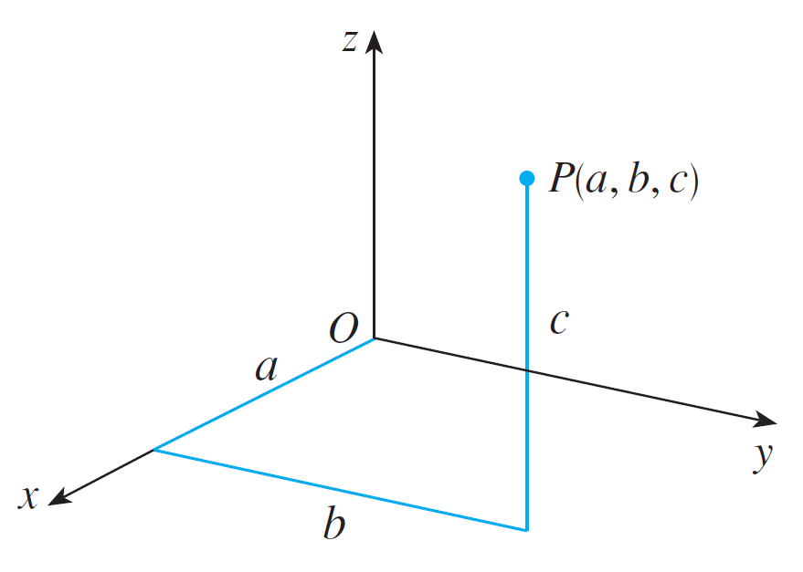
Three-Dimensional Coordinate Systems
Thus to locate the point (a, b, c) we can start at the origin O and move a units along the x-axis, then b units parallel to the y-axis, and then units c parallel to the z-axis as in Figure 4.
Figure 4

Slide 9
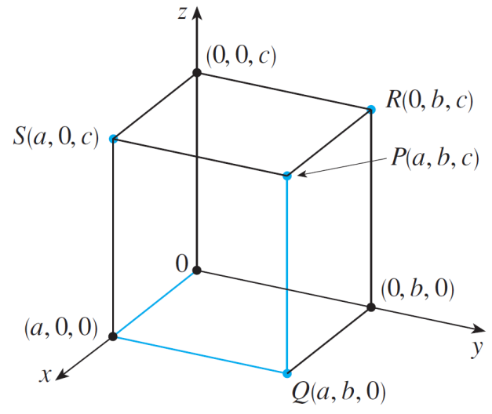
Three-Dimensional Coordinate Systems
The point P(a, b, c) determines a rectangular box as in Figure 5.
If we drop a perpendicular from P to the xy-plane, we get a point Q with coordinates (a, b, 0) called the projection of P on the xy-plane.
Figure 5

Slide 10

Three-Dimensional Coordinate Systems
Similarly, R(0, b, c) and S(a, 0, c) are the projections of P on the yz-plane and xz-plane, respectively.
The Cartesian product is the set of all ordered triples of real numbers and is denoted by
We have given a one-to-one correspondence between points P in space and ordered triples (a, b, c) in It is called a three-dimensional rectangular coordinate system.

Slide 11

Three-Dimensional Coordinate Systems
Notice that, in terms of coordinates, the first octant can be described as the set of points whose coordinates are all positive.
In two-dimensional analytic geometry, the graph of an equation involving x and y is a curve in
In three-dimensional analytic geometry, an equation in x, y, and z represents a surface in

Slide 12

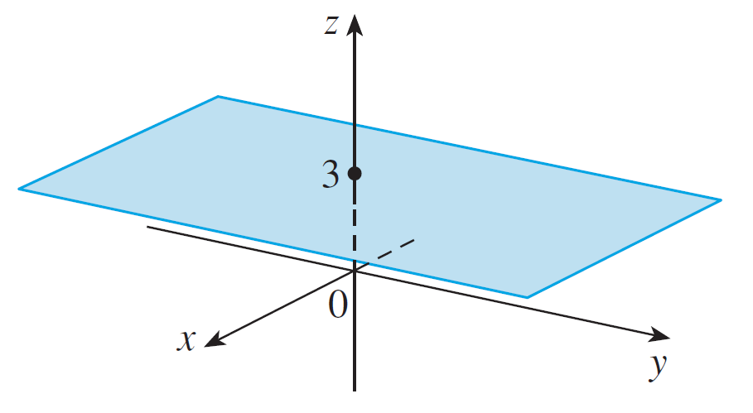

Example 1
What surfaces in are represented by the following equations?
(a) z = 3 (b) y = 5
Solution:
(a) The equation z = 3 represents the set
which is the set of all points in whose z-coordinate is 3.
This is the horizontal plane that
is parallel to the xy-plane and three
units above it as in Figure 7(a).
z = 3, a plane in
Figure 7(a)

Slide 13
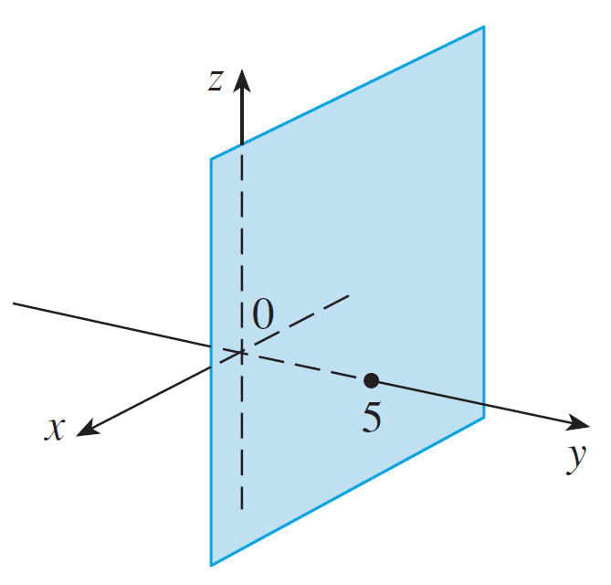
Example 1 – Solution
cont’d
(b) The equation y = 5 represents the set of all points in
whose y-coordinate is 5. This is the vertical plane that
is parallel to the xz-plane and five units to the right of it
as in Figure 7(b).
y = 5, a plane in
Figure 7(b)

Slide 14
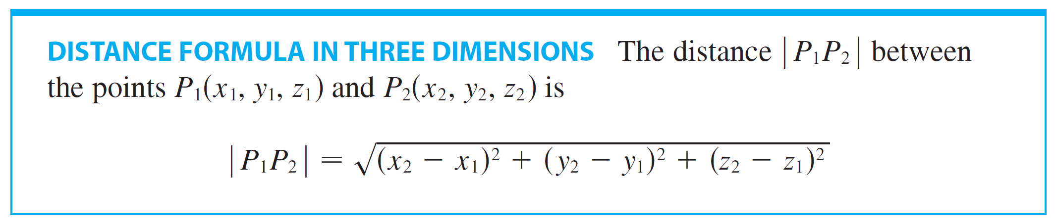
Three-Dimensional Coordinate Systems
In general, if k is a constant, then x = k represents a plane parallel to the yz-plane, y = k is a plane parallel to the
xz-plane, and z = k is a plane parallel to the xy-plane.
The familiar formula for the distance between two points in a plane is easily extended to the following three-dimensional formula.

Slide 15
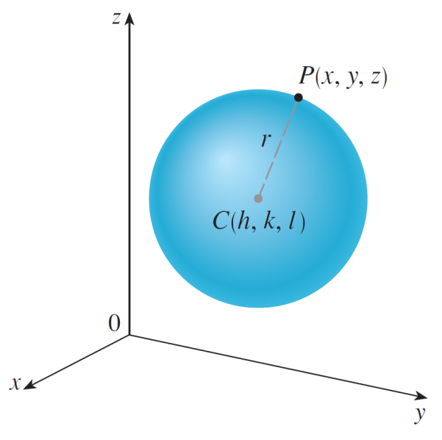
Example 4
Find an equation of a sphere with radius r and center
C(h, k, l).
Solution:
By definition, a sphere is the set of all
points P(x, y, z) whose distance from C
is r. (See Figure 10.)
Figure 10

Slide 16
Example 4 – Solution
cont’d
Thus P is on the sphere if and only if | PC | = r.
Squaring both sides, we have | PC |² = r² or

Slide 17
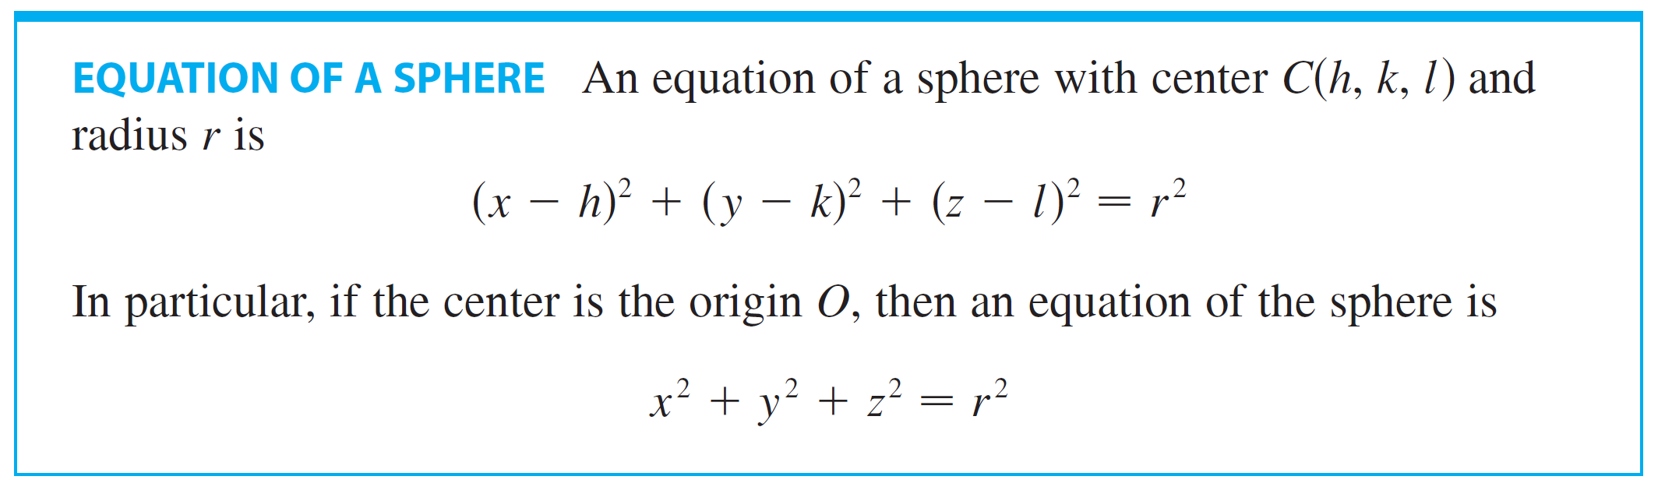
Three-Dimensional Coordinate Systems
The result of Example 4 is worth remembering.

